Slide 1
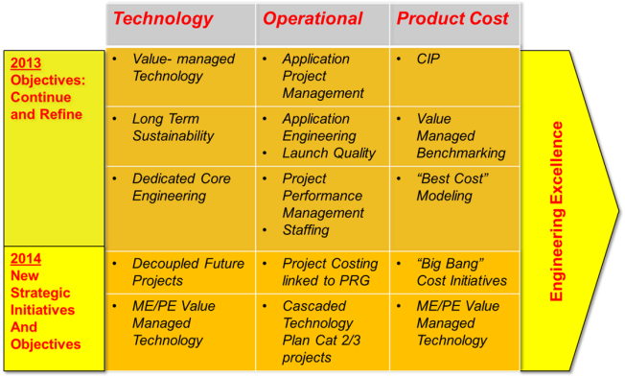


Value Managed Technology

Slide 2


Value-Managed Technology
Develop technologies to meet future customers and business needs
Ensure technology for future market growth and strength
All EPS Engineering projects managed and tracked in Technology Roadmap
Weekly meetings with cross functional group
Projects assessed and prioritized based on overall value
High risk projects reviewed weekly, others based upon scheduled cadence
Responsive development process
  Agile to move quickly for pursuit and early product development
  Disciplined to create robust designs to maximum use across the customer base
Project requirements defined for each project – exit criteria and timing
Linked to resource model to support budget and timing

Slide 3

2014 Engineering Goals
Create Best Technology to Drive Growth and Improve Profitability
 | Description | Target
12 | Develop Next Gen Products with Improved Value | 10%
Value Assessment Method and Definition
Each Tech Plan project assessed
Scale factor for multiple attributes
Considers trade offs between multiple attributes
Value = highest scalar rating relative to current state
Big Bang projects bundle high value projects to meet system level market segments/requirements

Slide 4
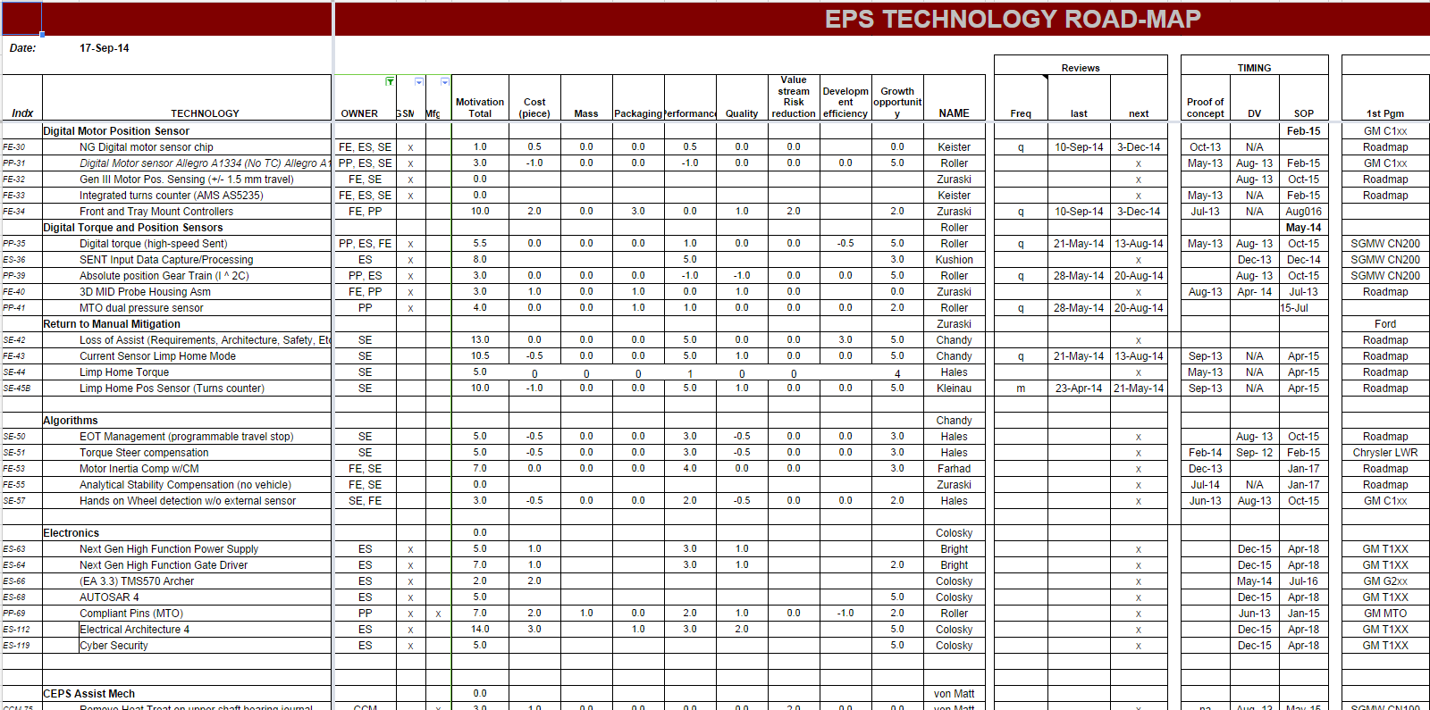
Technology Roadmap
Technology Roadmap is maintained and tracked
through an Excel/Google based tool
High Risk Items reviewed weekly
Item Description
Owners
Value Assessment
Review cadence
Timing

Slide 5
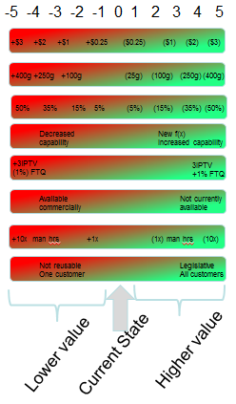
Value Attributes
  Each project assessed against 8 Attributes
    Piece Cost
    (total cost: including material, labor, investment, PC&L)
    Mass
    Packaging
    Performance
    Quality/Warranty/FTQ
    Value Stream Risk Reduction/Supplier Diversification/Fx protection, Logistics
    Development Efficiencies
    Growth Opportunity / Market Trends
      One vs. multiple customers
      Potential legislative requirements
      1st to market
  -5 to +5 Scale for each attribute (total avail points -40 to +40)
  Current production baseline set to zero
  Overall “10% Value Improvement” assessed against 40 possible points

Slide 6
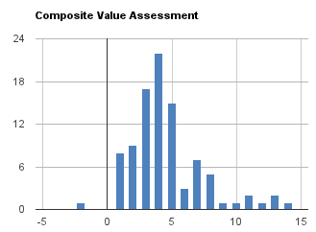

Tech Plan - Second Quarter Status
Project assessments being reviewed in weekly cross functional meeting for initial score
102 Total Active Projects
11.4% Value Improvement average
10% improvement
from current state

Slide 7
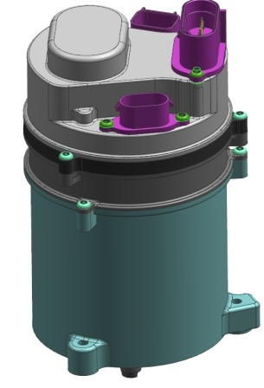
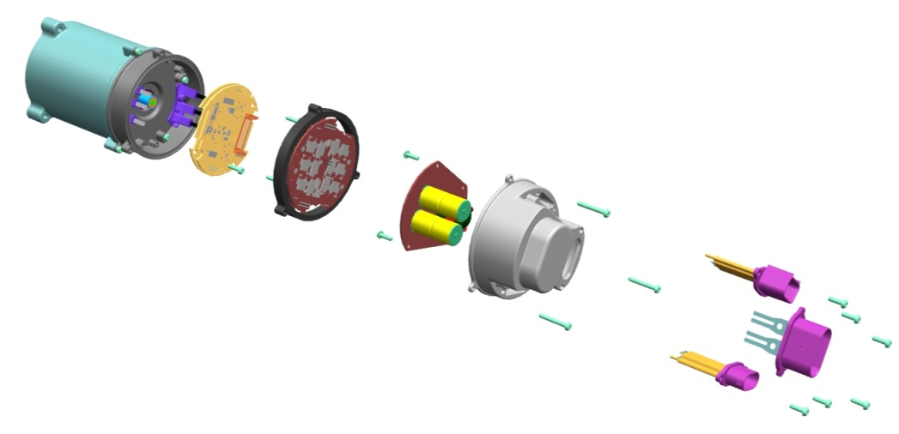
Examples of Value Managed Projects
One Pagers
GM Pursuit
Loss of Assist
Dual Wound / 12 FET Architecture
ECU minimization and MPP
De- coupled Technology Projects
  High Ratio/ Low Torque, CEPS
FE
CORE
APPLICATION
CURRENT
FE
CORE
APPLICATION
CURRENT
IBK Pursuit
FE
CORE
APPLICATION
CURRENT
FE
CORE
APPLICATION
CURRENT

Slide 8
Loss of Assist - Project Value Assessment
32% Value Improvement (score 13)
  Cost
    SW to full redundancy options
  Performance
  Mass
  Value Stream (supplier diversity, FX protection, Logistics)
  Packaging
  Quality/FTQ/Warranty (FTQ, PPM, Warranty)
  Customer/Market Requirements
    All customers requiring some level
    Potential legislative requirements
    Strong advantage to be first to market
    Level 3 and 4 most likely
+$3
+$2
+$1
+$0.25
($0.25)
($1)
($2)
($3)
Decreased
capability
New f(x)
Increased capability
+400g
(25g)
(100g)
(250g)
(400g)
+250g
+100g
+25g
Available commercially
Not currently available
+50%
+25%
+5%
(5%)
(25%)
50%
+3IPTV
(1%) FTQ
3IPTV
+1% FTQ
Main Driver
Not reusable
One customer
Legislative
All customers
Lower value
Higher value
Current State

Slide 9
Loss of Assist
Roadmap
Past
Today
2016
2017
2019+
Fail Safe Manual Steering
Automotive Standard Functional Safety
Enhanced Comfort in Faulted State
Reduced Failure / Warranty Rate
Fail Operational Steering
Most faults revert to manual steering
Engineered to general functional safety standard (IEC 61508)
Most faults revert to manual steering
Engineered to automotive functional safety standards (ISO 26262)
SW backup functions with degraded performance for some faults
Diagnostics design to increase system availability
Utilize existing HW
Limited HW redundancy with full performance for some faults
Reduced failure rate HW design for some subsystems
SW backup functions for some faults
Full or degraded performance under all faults
Required for some ADAS / Autonomous driving
May be required for high load steering applications
Technology adoption rate accelerated by recent GM recalls
Rapid Technology Growth

Slide 10
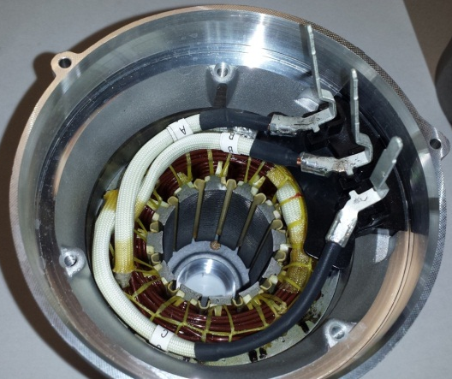
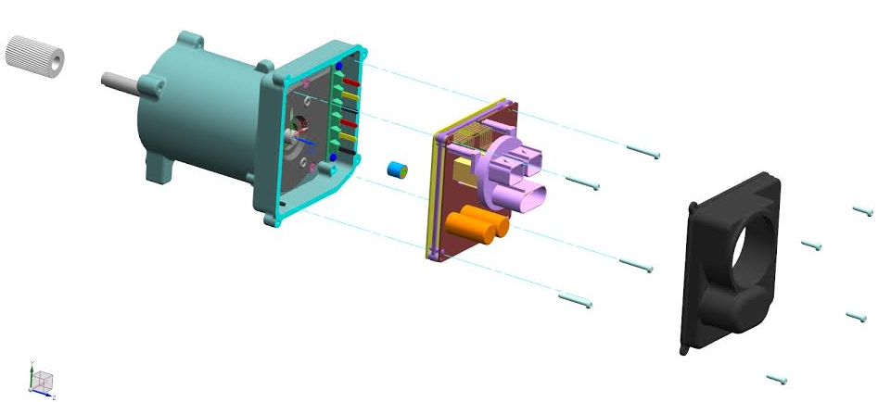
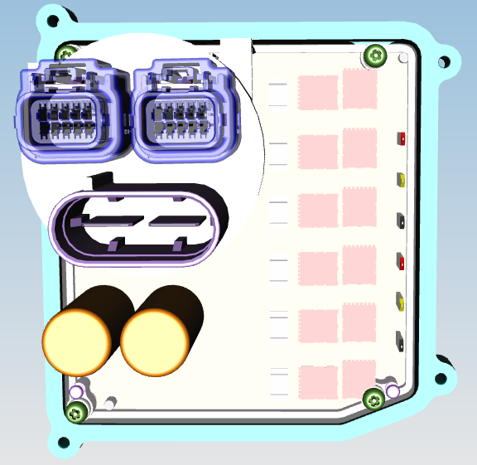
Dual Wound Motor & Dual Inverter
Dual Wound Motor
(6-phase leads instead
of 3-phase leads)
Two Motor/Inverter solutions for:
1. LOA- 12/8 Dual Wound, Dual Inverter and Dual Micro
2. Performance- 12/8 or 9/6 Dual Wound, Dual Inverter and Single Micro.
Dual Inverter CCA
(12-power FETs instead
of 6-power FETs)
Ken Webber Thanks to: Rakib Islam

Slide 11
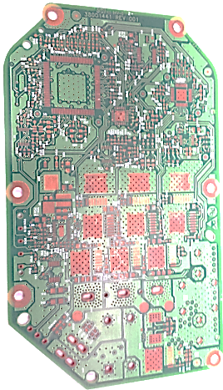
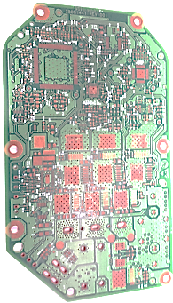
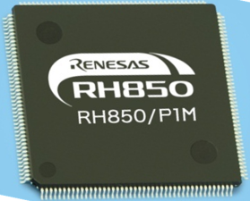
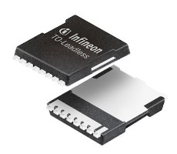
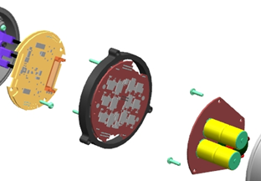
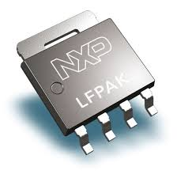
ECU minimization and MPP
Industry demands for more circuit
content in future demands
Industry demand for smaller packages
Development work underway to:
  Reduce PCB trace spacing and increase component density
  Develop and use smaller components
    FETS, EA 4.0 Micro, MSB sensor chips
  Blind and buried vias, combining vias and test points
  Separate single layer boards when required to:
    Optimize assembly with compliant pins
    Optimize header/leadframe cost and designs
  Smaller single layer/end mount still preferred
10x10mm
5x6mm

Slide 12
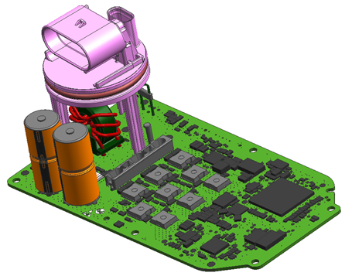
PP-127: Optimize CCA Packaging
Description
  Reduce existing BMW CCA size by 25% using evolutionary design and component updates
  Evaluate simple and reusable lead frame for connectors, inductor and bulk caps
Motivation (3)
  Reduced CCA packaging
  Maintain CCA cost advantage vs. complex lead frame and multiple PCB designs used by competitors
  Potential reuse of power lead frame
Deliverables
  Build and evaluate development CCAs
  Cost request
  Leverage competitive analysis
Timing
  1Q 2015
Team Members/Customers
  Wayne Thomas
  Ryan Yaklin
Design Scope
Blind/Buried Vias
Vias in Pad
Test Point Optimization
Component Packages
Lead Frame Development
Thermal Management
Planar Magnetics
Compliant Pins
Keep Out Zones
Label Requirements

Slide 13

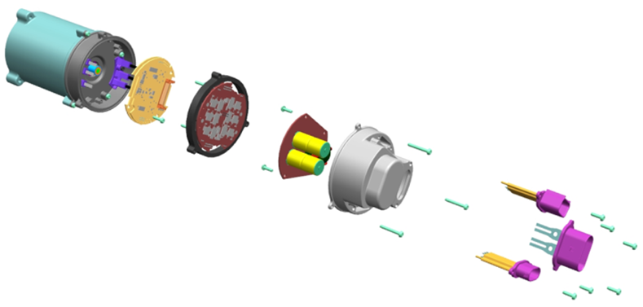
PP-127: Optimize CCA Packaging
Description
  Modularize CCA into three units to allow stacking of boards
    Power (Bulk Caps, Common Mode Choke, Battery Disconnect)
    Motor drive circuit (FETs, Gate Drive)
    Logic (Microprocessor, HALL Sensor)
Motivation (-3)
  Improved overall controller size to fit within motor diameter. (Customer packaging requirement)
  Potential reuse of modules for other customers
Deliverables
  Validated design for BMW/Daimler IBK/MRA2
Timing
  BMW/Daimler IBK/MRA2 SOP 2019
Team Members/Customers
  Dan Klenk
  Ryan Yaklin
  Delynn Streng

Slide 14
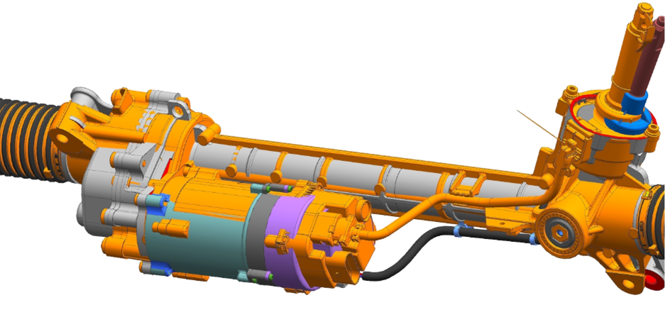
IBK/GM Golden Brick/Competitor Benchmark

Slide 15
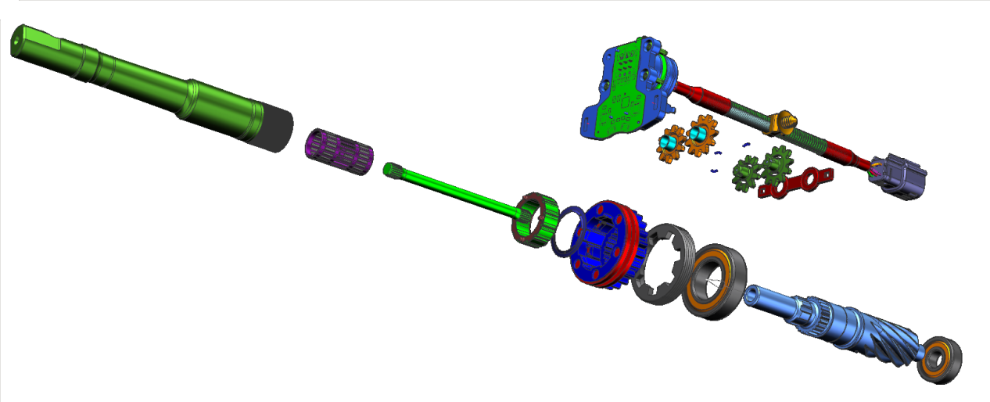
PP-144: Absolute Handwheel Position Digital Sensor (Dual Spur Gear - SENT)
Description
  Digital Absolute Handwheel Position Sensor using SENT protocol to replace current I2C
Motivation (TBD)
  Electrical Architecture 4 compatibility
Deliverables
  Digital probe housing assembly for multiple programs
  New Calibration Equipment
Timing
  GM T1xx (2018 - SOP)
Team Members/Customers
  Keith Kidder
  Jim Hoppenrath
  Joe Abate

Slide 16
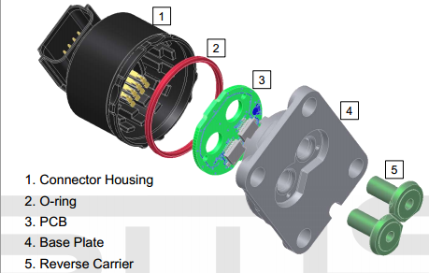
PP-41: MTO Dual Pressure Sensor
Description
  Dual Channel Pressure Sensor to support the MTO program
Motivation (4.5)
  Enabler for MTO implementation
  Provide Additional Business Opportunity for HPS
Deliverables
  Sensor Development with SMS (new supplier)
Timing
  GM K2xx – SOP 2015
Team Members/Customers
  Keith Kidder
  Brenda Martin
  Jason Dutsky
  Jordan Roe
  Joel Birsching

Slide 17
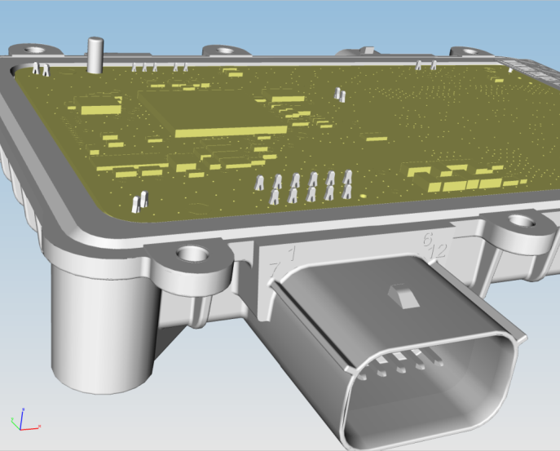
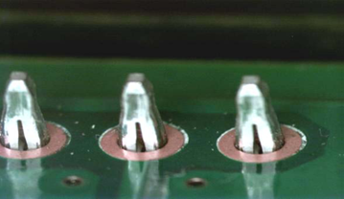
PP-69: Compliant Pins (MTO)
Description
  Utilize compliant pins for CCA retention to housing
  Utilize compliant pins for electrical connections
Motivation (7)
  Improved mechanical retention
  Elimination of PTH processes
  Eliminate solder cracking due to thermal expansion
  Concern about solder joint fatigue with limited package space
Deliverables
  Validated design for GM K2xx MTO
Timing
  GM K2xx MTO SOP 2015
Team Members/Customers
  Dan Klenk
  Thomas Rytlewski
  Brenda Martin
  Jordan Roe

Slide 18
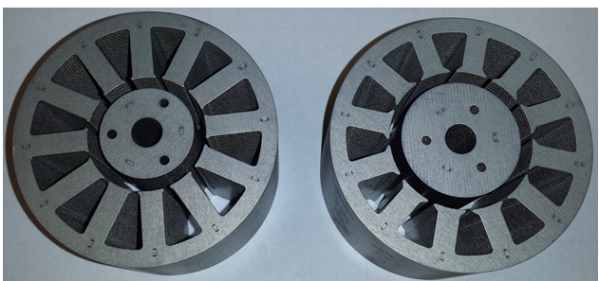
PP-123: Optimized High Output Motor Design (Rotor Diameter?)
Description
  Develop High Output Motor
Motivation ( 5)
  Reduce Overall Packaging Length of Motor Power Pack to aid in Customer Packaging Requirement
Deliverables
  Determine if Larger OD Rotor is a Output Advantage
Timing
  PSA 1V5 (2016 - SOP)
Team Members/Customers
  Rakib Islam
  Steve Collier-Hallman
  Ken Webber
  John Redwine
  Brian Williams

Slide 19
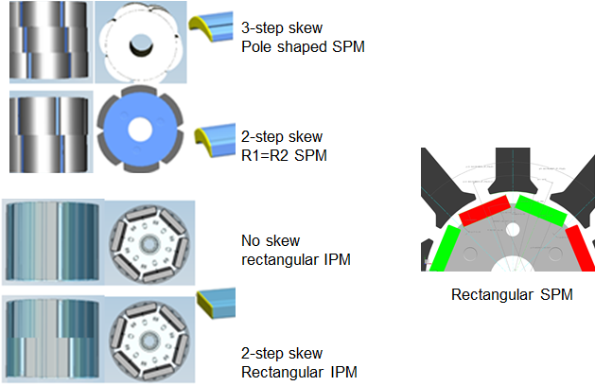
PP-124: Cost Optimized Motor Design (IPM/skew/pole shape/WIH)
Description
  Develop Cost Optimized Motor
Motivation ( 10)
  Reduce Material cost in Motor
Deliverables
  Determine if Larger OD Rotor is a Cost Advantage
  Determine if Higher Grade Magnets vs cost is a feasible option
  Determine which stator / winding design is optimal for cost
  Determine if shape of magnet has cost impact
Timing
  PSA 1V5 (2016 - SOP)
Team Members/Customers
  Rakib Islam
  Bryan Williams
  Ken Webber
  Steve Collier-Hallman
  John Redwine

Slide 20
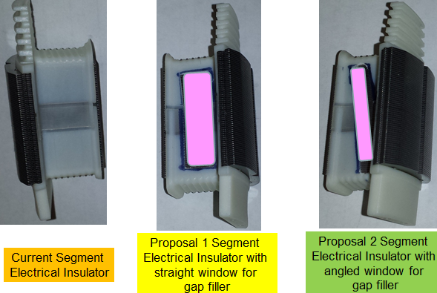
PP-126: Heat Management for Motor
Description
  Reduce Motor generated heat from Segment/Needle Stator designs
Motivation ( 9)
  Segment and Needle Wind Motors with plastic Insulators generate more heat than Shed Wound motors
Deliverables
  Determine if gap filler can be added prior to winding to get direct heat transfer to stator
  Determine if thermally conductive coatings (Bergquist epoxy coat) on stator instead of plastic insulator reduces motor thermals.
  Determine which stator / winding design is optimal for thermals
Timing
  BMW (2014 - Nov.)
Team Members/Customers
  Rakib Islam
  Bryan Williams
  Ken Webber
  Joanne Tersigni
  Julie Kleinau

Slide 21
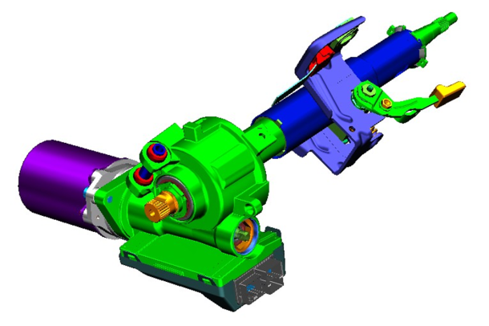
CEPS Low Cost Low Output
Description
  A CEPS assembly for low torque applications (<45 Nm) which employs brushless motor technology and exploring higher worm/gear ratio.
Motivation
  Reduce FTQ noise issues seen with current brush motor of low output CEPS
  Reduce CEPS brushless assist assembly cost (similar to brush system)
Deliverables
  Phase I- 28:1 issue generation and verification
  Packaging comparison to 15:1 and 22:1
  System configuration / architecture concepts and selection
  Design and develop initial prototype system
  Initial Cost/MSD
  Performance results: bench and vehicle
Timing
  Old research gathering May 2014
  Concept development and analysis / Selection: July 2014
  Concept design and build: October 2014
Team Members/Customers
  Steve Collier-Hallman, Brian Magnus, Rakib Islam, Paul Fisher, Jeff Beyerlein, Joel Bickel

Slide 22
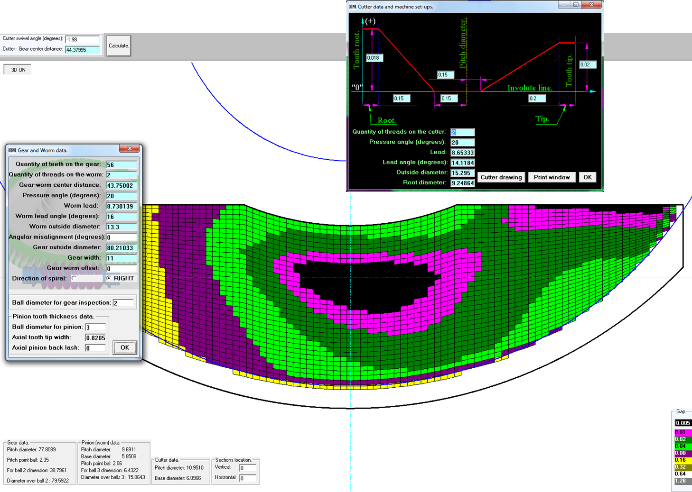
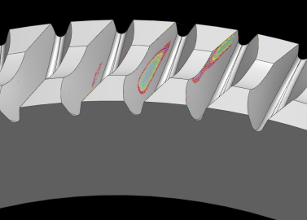

CEPS Low Cost Low Output
Study of multiple worm gear designs completed
  Packaging size (goal to fit in current 15:1 or 22:1 package)
  Gear pattern analysis
  Load capacity analysis
Three designs chosen to build and evaluate
  28:1, 43.75 mm CD (SGMW), 80.21 mm OD (slightly larger than SGMW), 11 mm wide
  30:1, 43.75 mm CD (SGMW), 80.27 mm OD (slightly larger than SGMW), 14 mm wide
  31:1, 52.00 mm CD (Gamma), 95.92 mm OD (slightly larger than Gamma), 11 mm wide
Prints for gear hobs, worm shaft blanks, worm shafts, and gears are complete and are either at quoting or ordered
NVH running noise test set-up design complete; drawings in process

Slide 23

PM Synchronous Reluctance Motor and Control
Description
  Develop PM Synchronous motor and controls for EPS
Motivation
  Reduce dependence on rare Earth metals (Dy free)
  Reduce motor cost (magnet material volume reduction)
Deliverables
  Electromagnetic and mechanical design
  Sensitivity analysis
  Build prototype parts
  Modified/new control algorithms
  Power off and on dyno test results
Timing
  Analysis and design by Q4 2014
  Procure components and build prototype motors by Q2 2015
  Test motors and quantify speed/torque, cogging and torque ripple performance end of Q2
Team Members/Customers
  Alejandro Ortega, Brian Magnus, Dennis Skellenger/ Neal Roller, Rakib Islam, Julie Kleinau

Slide 24
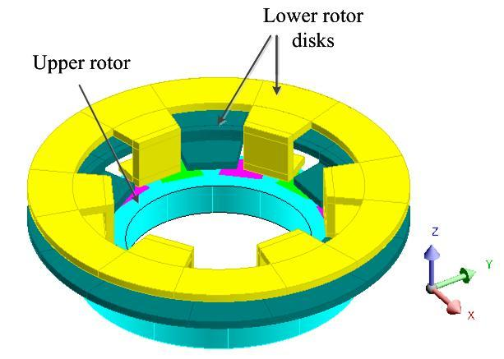
Low Cost Small Diameter Torque Sensor
Description
  Develop torque sensor for EPS application
Motivation
  Reduce size of the sensor
  Reduce cost of the sensor
  Improve sensor performance
Deliverables
  Next generation design
Timing
  ?
Team Members/Customers
  Subhra Paul/ Rakib Islam, Keith Kidder

Slide 25
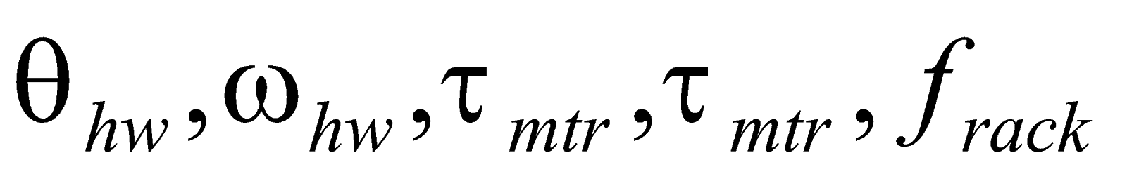
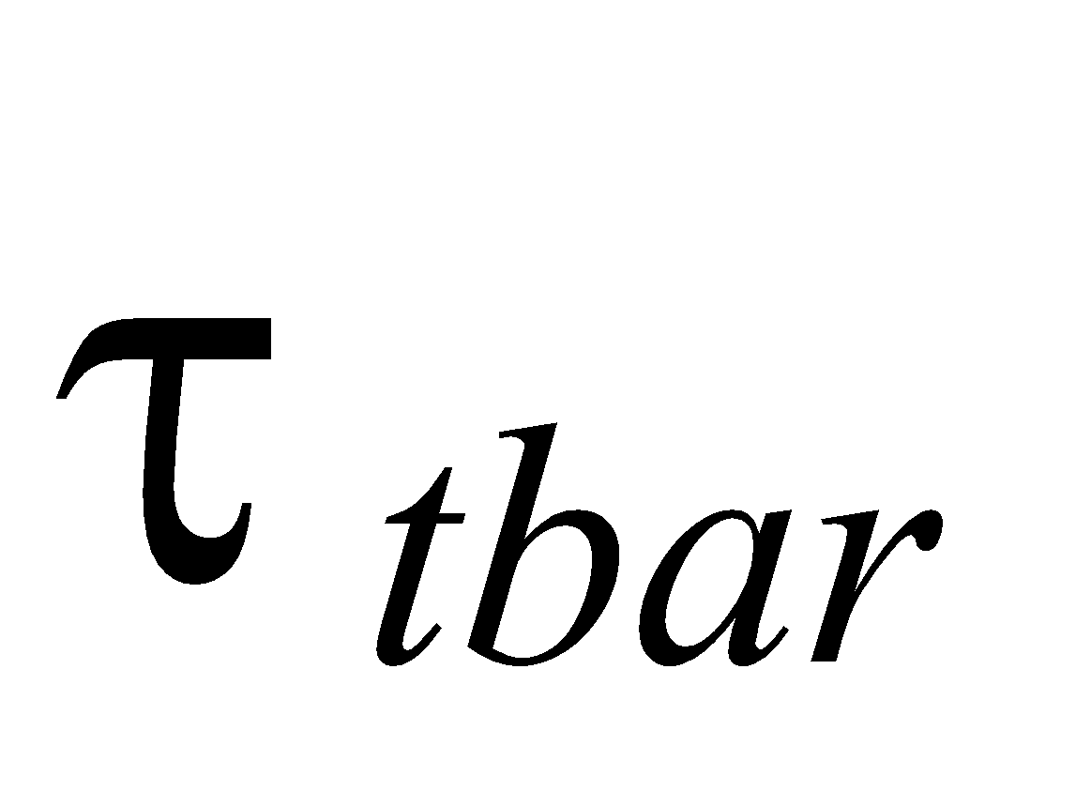
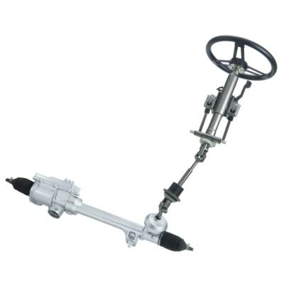
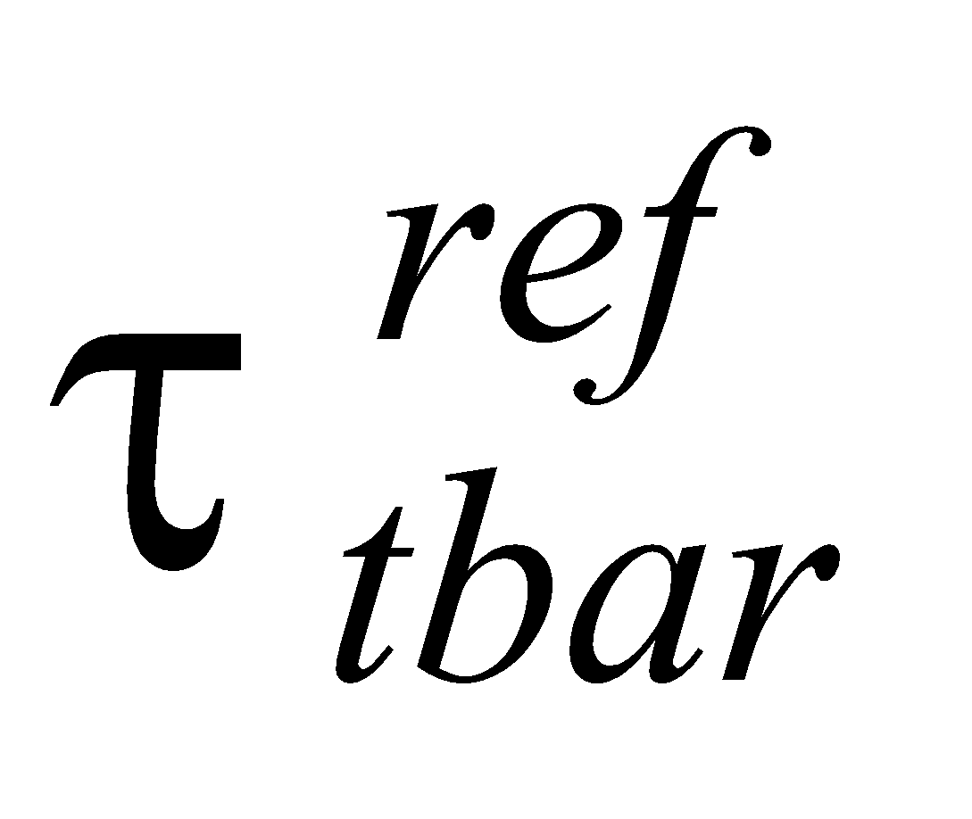


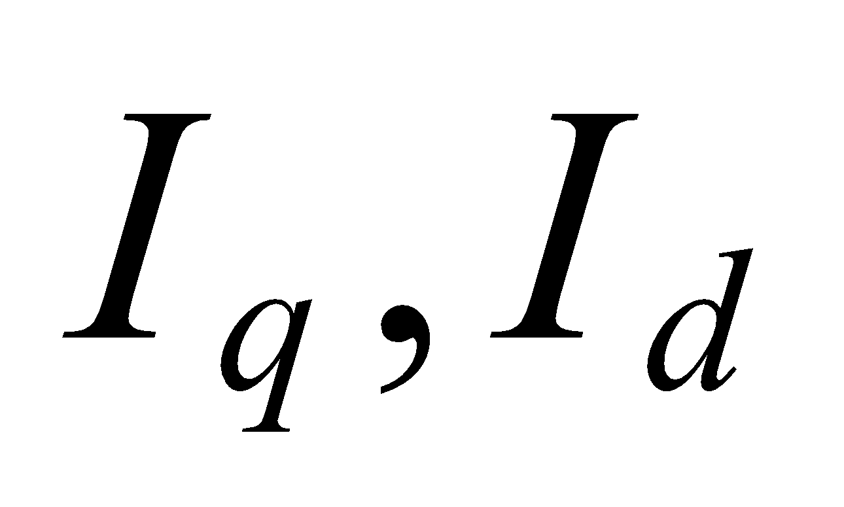
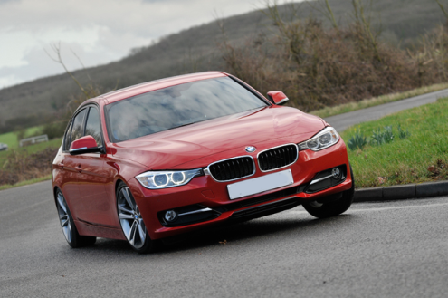
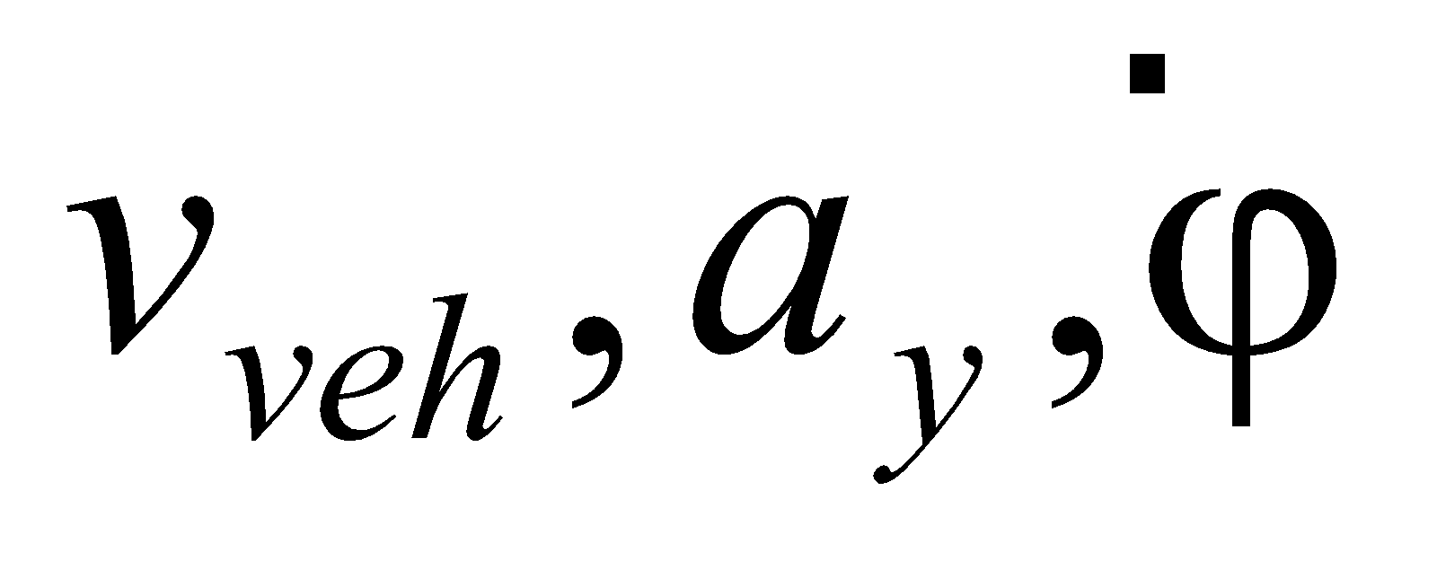
Closed Loop Steering Synthesis
Description
  Control the driver’s steering torque to follow the reference torque, which is generated based on various vehicle and EPS signals for premium steering feel.
Motivation
  Tuning Simplification
    Decoupled tuning parameters
    Reduced number of calibration and tuning time
  Intuitive and direct tuning parametric interface
    Tune steering feel directly instead of iterative approach
  Tuning consistency
    Tune across platforms with simple calibration changes
Deliverables
  Determine the best methodology of steering synthesis and closed loop control for steering feel
  Prototype EPS software
Timing
  Angle-based Steering Synthesis in-vehicle evaluation: 01/14 (complete)
  Steering Synthesis based on rack load (measured & estimated) in-vehicle evaluation: Q1/14
  External Demo (Daimler): Q3/14
  Comprehensive in-vehicle evaluation and winter test: Q4/14
Team Members/Customers
  Tao Yang, Farhad Bolourchi, Abdullah Husain, Tejas Varunjikar, Michael Hales, Steve Klein, Mariam George, Shrenik Shah, Jens Dittmer / Mark H, Ashok C.
Steering Feel Configurator
Torque Feedback Controller
Current Controller

